Slide 1
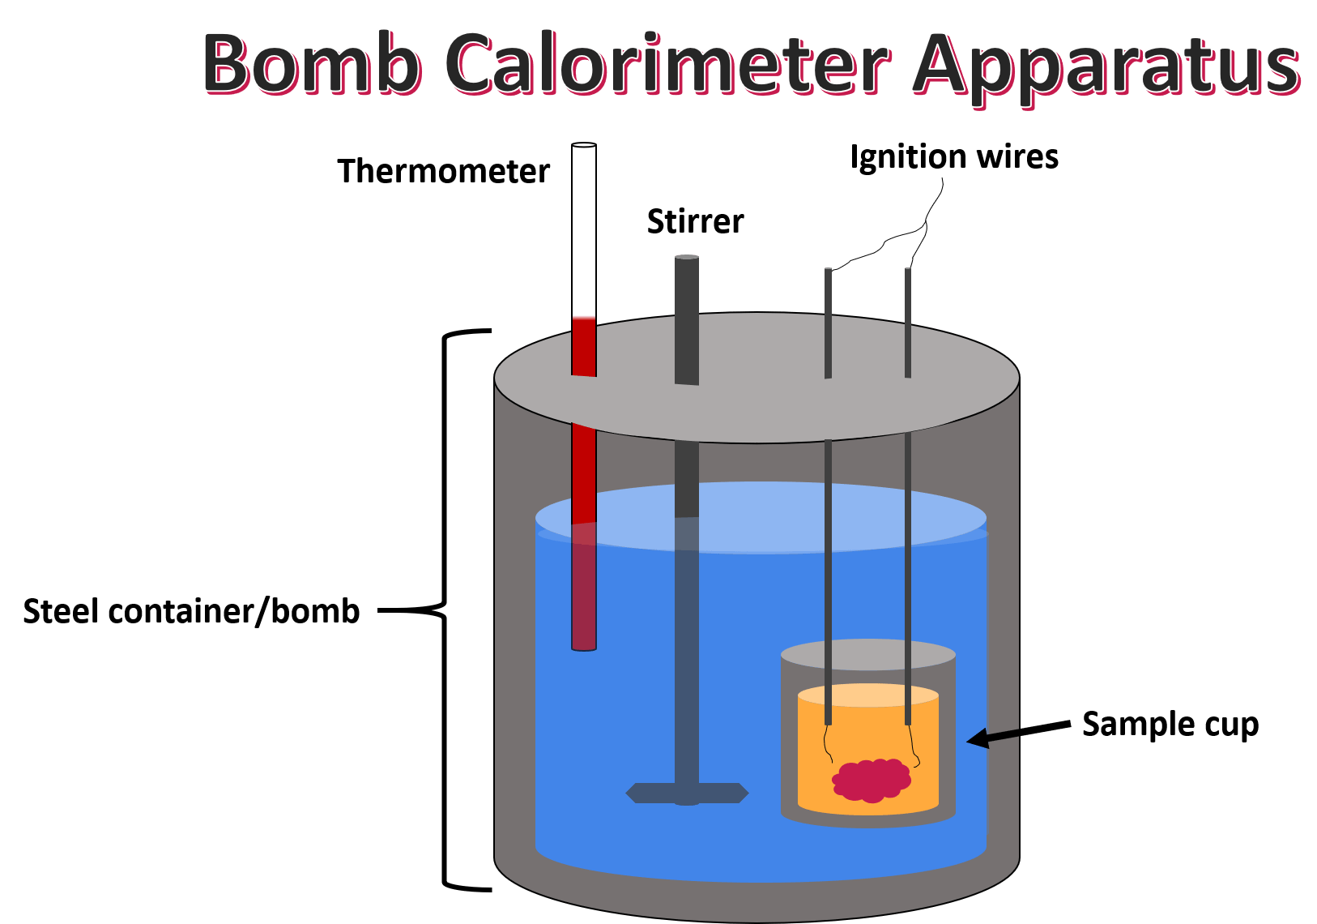

Bomb calorimeters tell us the heat ($q$) evolved during a chemical reaction
Reaction vessel
$$q$$

Slide 2
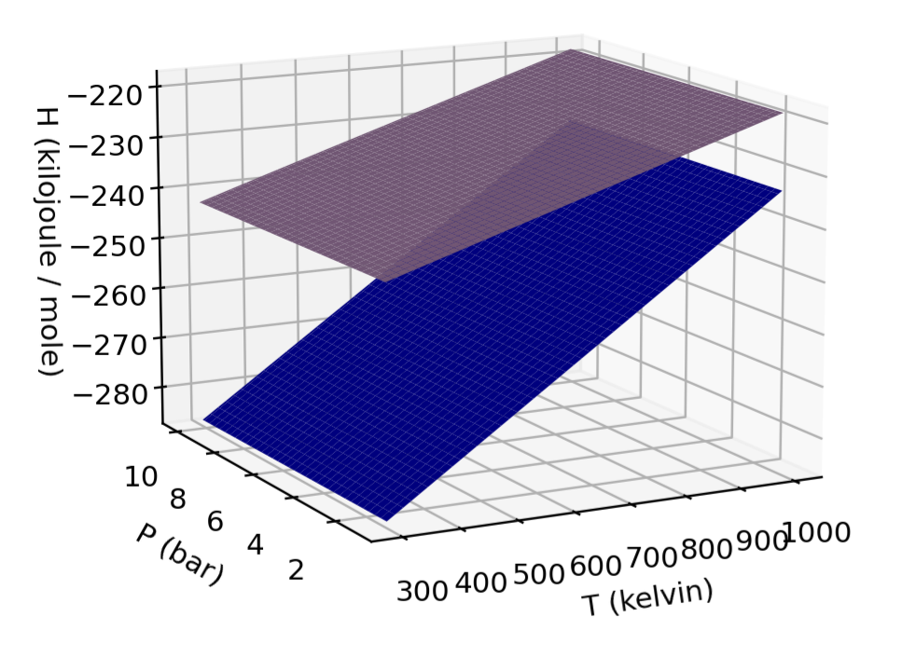
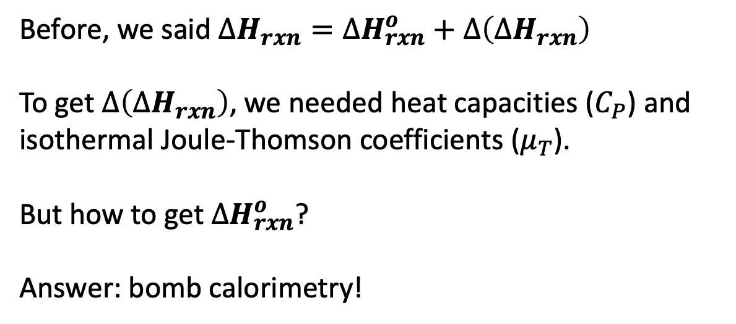
$∆H_{rxn}^{o}$
Before, we said $∆H_{rxn}=∆H_{rxn}^{o}+∆\left(∆H_{rxn}\right)$
To get $∆\left(∆H_{rxn}\right)$, we needed heat capacities ($C_{P}$) and isothermal Joule-Thomson coefficients ($μ_{T}$).
But how to get $∆H_{rxn}^{o}$?
Answer: bomb calorimetry!
$$products$$
$$reactants$$
Reaction vessel
$$q$$

Slide 3
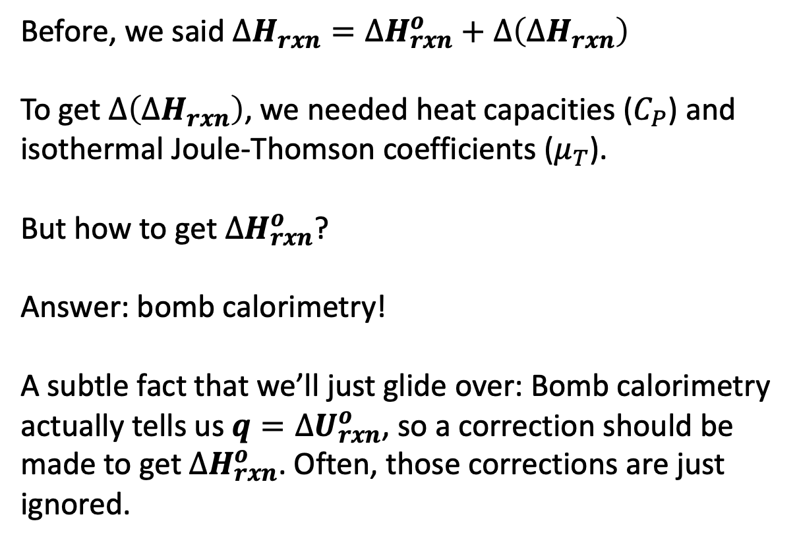


$∆H_{rxn}^{o}$
Before, we said $∆H_{rxn}=∆H_{rxn}^{o}+∆\left(∆H_{rxn}\right)$
To get $∆\left(∆H_{rxn}\right)$, we needed heat capacities ($C_{P}$) and isothermal Joule-Thomson coefficients ($μ_{T}$).
But how to get $∆H_{rxn}^{o}$?
Answer: bomb calorimetry!
A subtle fact that we’ll just glide over: Bomb calorimetry actually tells us $q=∆U_{rxn}^{o}$, so a correction should be made to get $∆H_{rxn}^{o}$. Often, those corrections are just ignored.
$$products$$
$$reactants$$
Reaction vessel can’t expand, so there’s no work
$$q$$

